Slide 1
Instructor Certification Program On Snow Instructor Seminar Safe and logical progression to on snow (OS) training
Brian Low
National Manager
Instructor Certification Program
brian.low@skipatrol.ca
FIPS 2022
Notes:
The following information presented at FIPS is part of one module of the CSP On Snow Instructor Certification program. This presentation at FIPS is focused on the “Science of Toboggan Driving” and the new approach being taken to safely and effectively train new patrollers and requalify returning patrollers.
Outcome: Following the completion of this module, the instructor will use available resources and follow the progression for on snow training providing a consistent instructional approach to complement the efforts of colleague instructors on the on snow team.
The CSP is currently revising the OS operations manual and updating all OS training modules. This module reflects this transition when discussing the progression in on snow training and qualification. There will be elements of this presentation that may be different from existing manual references or module content. The manual, training modules and seminar will all reflect congruence and complement each other when the initiative is complete. Instructors will be briefed on changes to the OS modules in their OS IYU.
It is the responsibility of the instructor to regularly review instructional information and remain current and up to date related to CSP training expectations. If there are specific questions that arise as the result of observed differences in material from these sources, please contact the ICP national coordinator or On Snow national coordinator for clarification.
There are detailed notes provided with each slide in this module. It is to the advantage of each instructor participant to have a copy or access to the entire seminar, but particularly this module.
The instructor will:
clearly prioritize the importance for a candidate to appreciate the need for safety and risk management at all times
have reviewed the entire OS curriculum and progressions, understanding when some topics must be taught in sequence and others may be completed at opportune times or in conjunction with other topics
understand the progression from basic knowledge of the site and terrain, to the development of the required ski/ride ability to maneuver in assigned terrain, to the knowledge and skill necessary to professionally use all treatment, rescue and transport equipment at the assigned location
Understand and follow the progression of on snow training from site knowledge, to ski/ride ability, to incident scene management, to pre-toboggan skills, to toboggan driving and support.
The instructor will have a “big picture” view of the progression and content of the OS curriculum and understand the flow in interrelationship of topics rather than view each class or session as distinct and separate. The OS course is an accumulation of knowledge and skill sets leading to the final product – a qualified OS patroller.
This module is not intended to replace on snow instructional modules provided on the national data base. On snow instructors will utilize and follow the existing modules and manual references subject to the changes noted within this module.
It is suggested that this module be shared with participants (along with others) for review and reference when preparing to instruct.
When detailed questions on CSP protocol or technique are raised, refer to the OS operations manual, videos, modules for reference. Further questions may be directed to the national ICP manager and/or national OS manager.

Slide 2
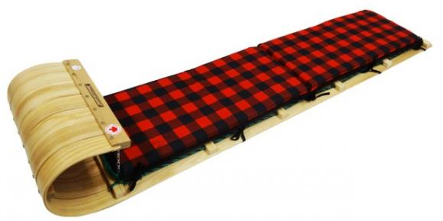
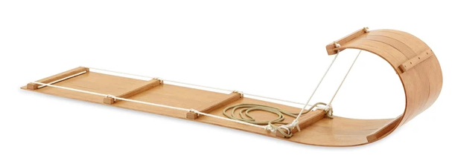
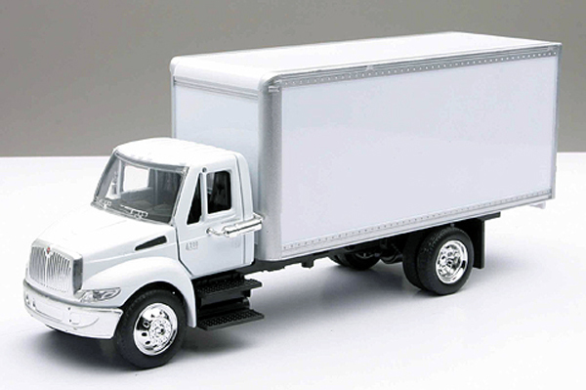
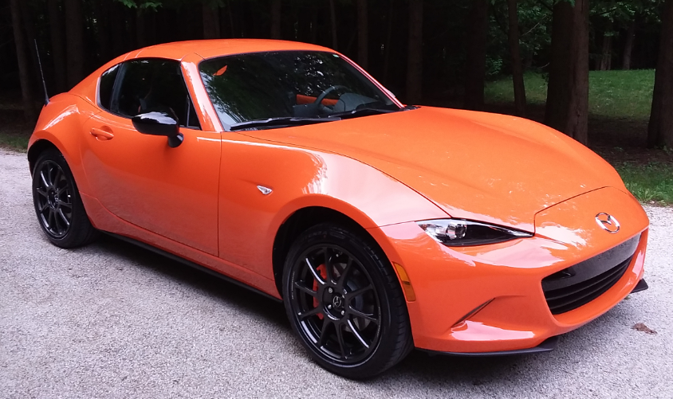
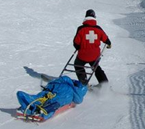
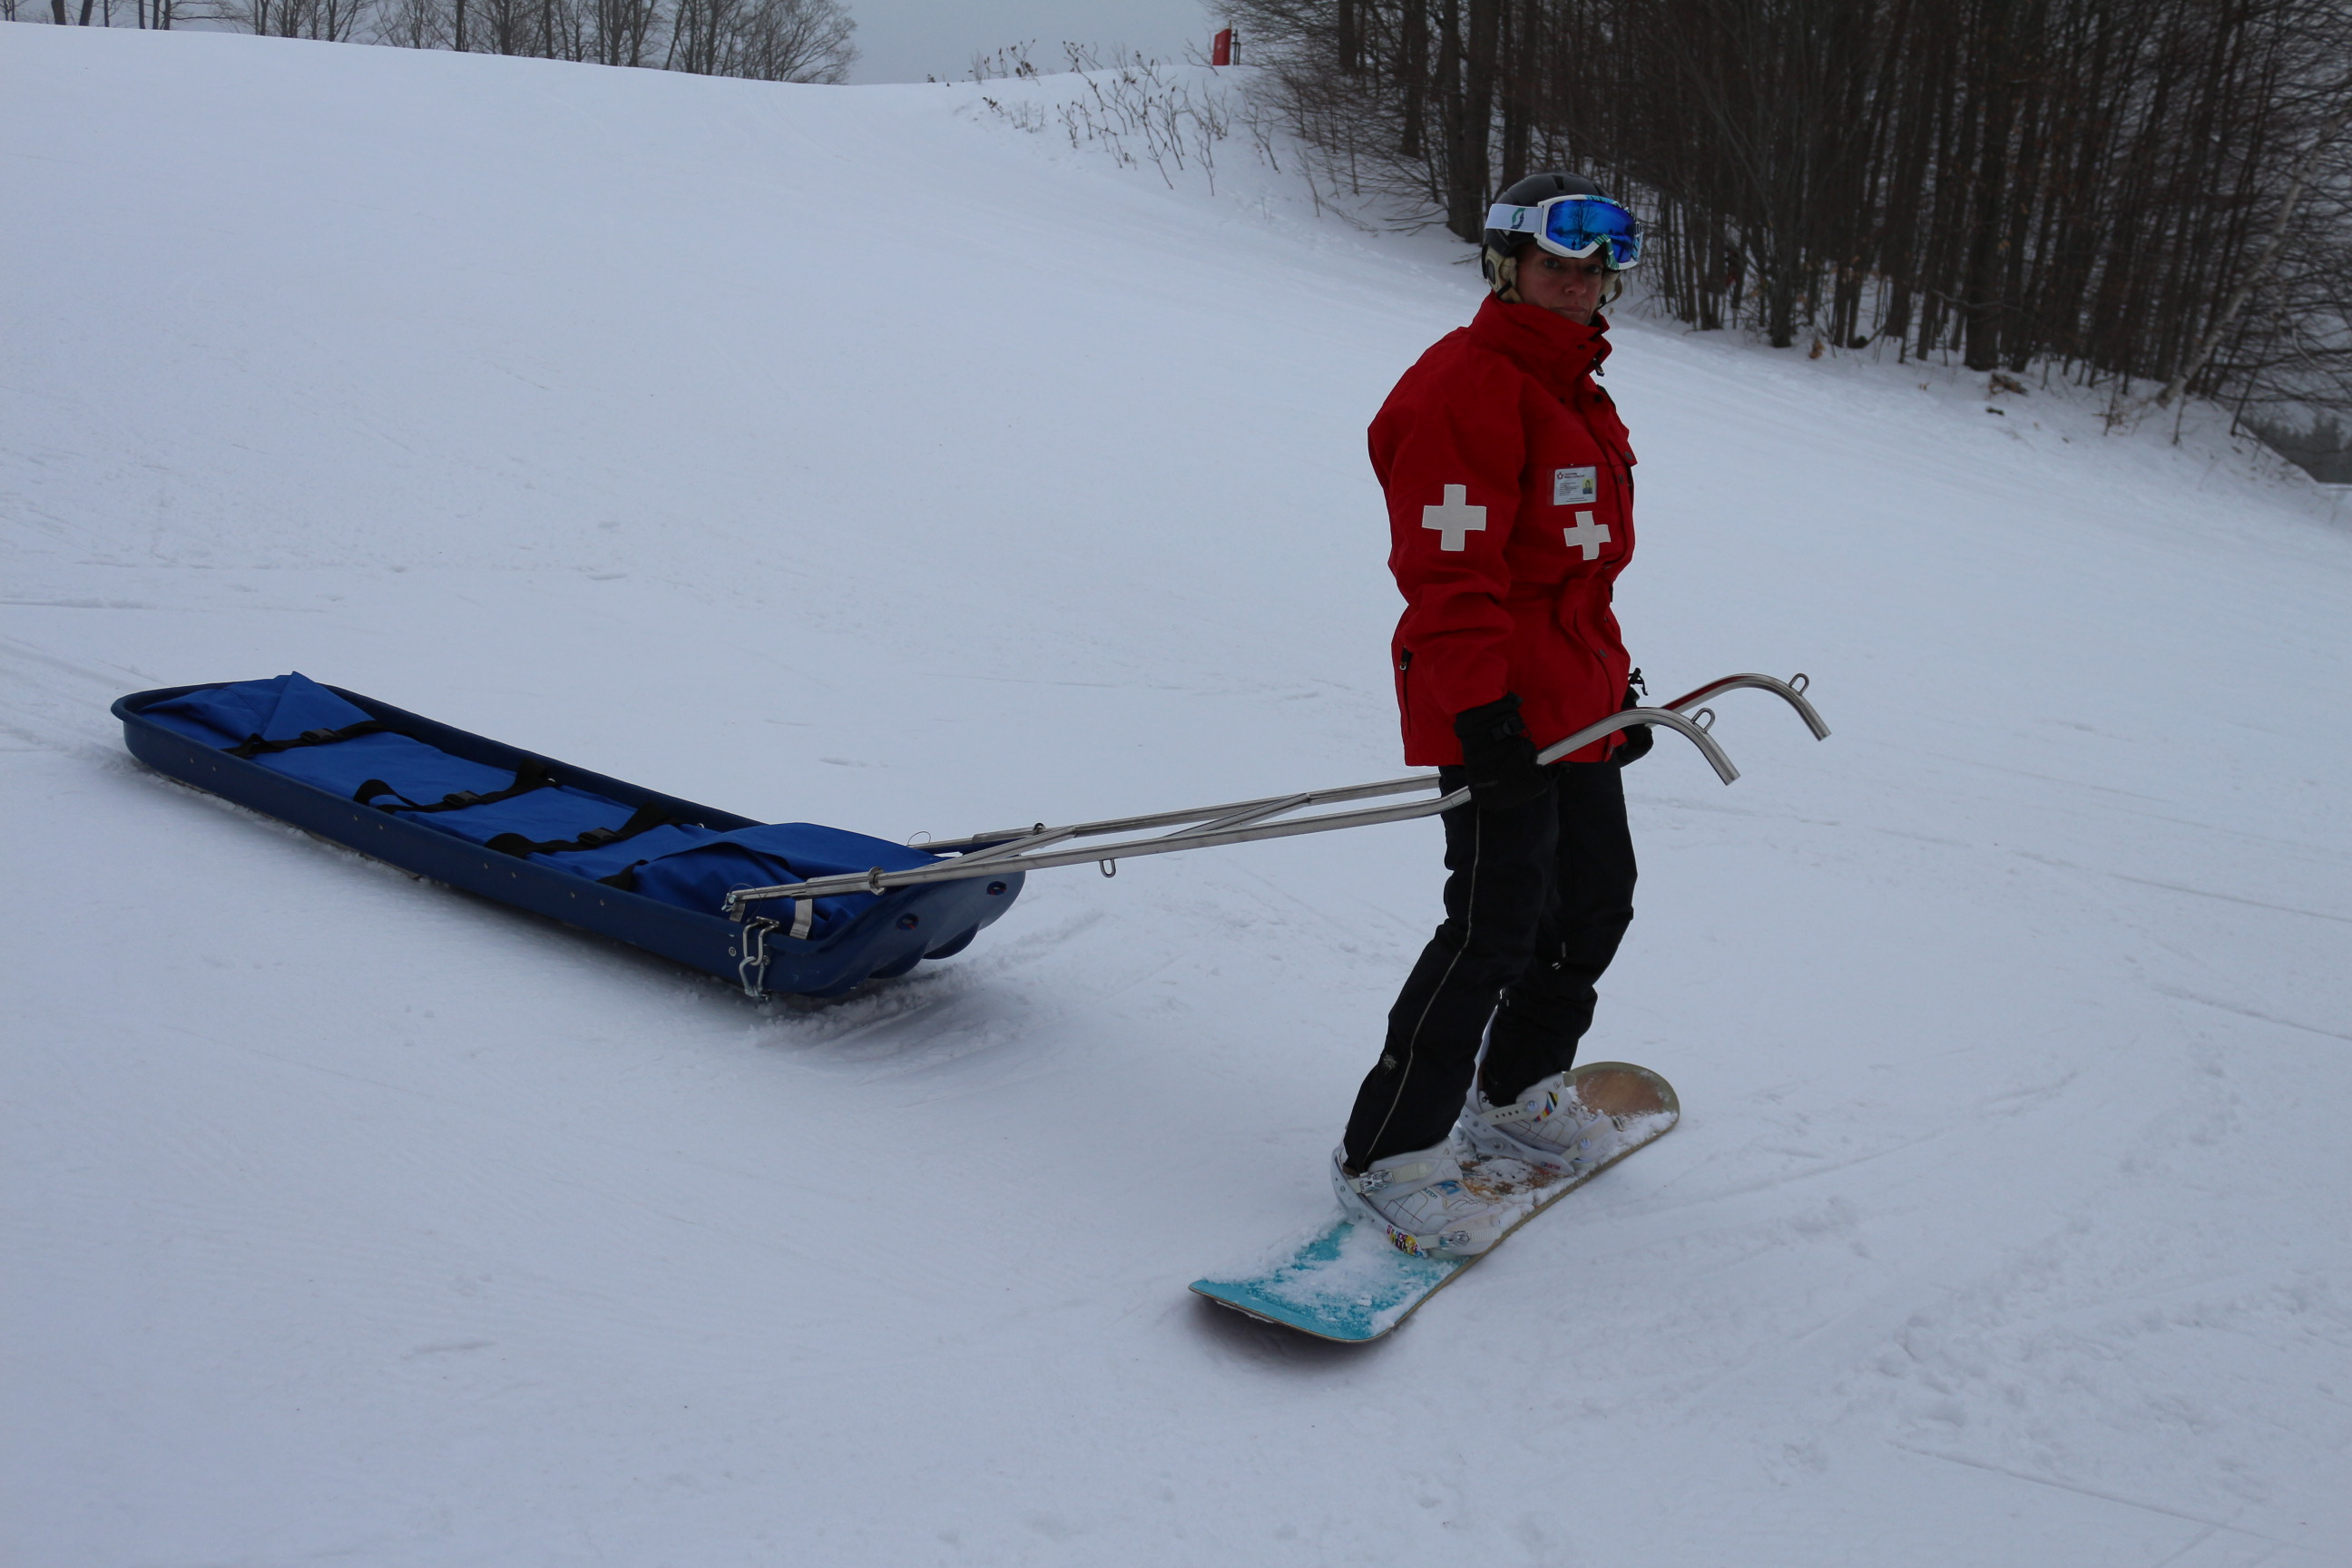
The toboggan as a vehicle
What we knew as kids
What we know as adults
What we LEARN
as patrollers
Toboggans, like vehicles, are not all made the same!
Notes:
The toboggans used by the Canadian Ski Patrol are uniquely designed for the purpose they are intended for – transporting injured patients to the next level of care.
Children, teens, and adults who are recreational skiers may have had experience with the traditional wooden toboggan, but have no familiarity with the CSP toboggans unless as a patient.
A new patroller has no experience with the CSP toboggan design, mechanics or driving characteristics.
Adults are familiar with motor vehicles. Familiar with the “responsibility” as a driver for the steering and braking control, loading, passenger safety, and upkeep for their vehicle. Their responsibility for driving CSP toboggans is similar. The learning progression to become knowledgeable about the CSP toboggans can be compared to a person beginning driver training and attending classroom sessions prior to sitting in the car in a very controlled setting to begin the first steps leading to driving.
The CSP approach to being familiar with and driving CSP toboggans builds on the experience and comfort most new patrollers will have from their vehicle driving learning experience.
Consider the toboggan as a “vehicle”, something everyone is familiar with. These vehicles (toboggans) come in different makes, models and have different features, steering, braking and driving characteristics. There are four makes of toboggans primarily in use by the CSP in Canada. Each make of toboggan includes a variety of models with different features.
Toboggans with different features drive differently. The features and characteristics that are critical to successful toboggan driving can be compared between toboggans. This will occur when addressing the toboggan driving progression.
Even though a patroller may patrol at a resort with one toboggan, they must be aware that if travelling and visiting another resort, driving different toboggans require different skills and knowledge.
Each of the following characteristics impact the driving of a toboggan.
Compare:
Hull design:
flat
concave
rockered
bevelled
position of upsweep at front relative to handle attachments (fulcrum effect)
stiffness
additional runners (e.g.. edge polyethylene [ski base] runners
Hull composition:
fiberglass
kevlar
Runners / skegs:
length
depth
shape
cant (angled out or straight up)
number (one each side or also in middle)
Driving handle attachments and locking:
distance between hinge and locking mechanism (fulcrum effect)
locking mechanisms (vary between makes and models)
Brake (Chain):
fixed or “on the fly” retractable chain
single, double chain
size
added barb(s) on chain
position of chain on hull when fully engaged (on flat portion or upward swoop/rocker)
Tail rope (emergency brake):
attachments
length
The features, driving characteristics and instructions for each make of toboggan used by the CSP are described within the toboggan driving section in later slides.
The distribution of the load in a toboggan changes the driving characteristics of that toboggan. Each toboggan has unique load distribution effects. All toboggans (vehicles) are not the same in this respect. These characteristics will also be described for each make of toboggan in later slides.
Section C) Equipment cont’d:
Toboggan inspection: - the setup
introduce the toboggan to new patrollers as their “commercial vehicle” and the new patroller as a “commercial driver”
to drive their commercial vehicle they must received advanced training and must demonstrated advanced knowledge and skills both before and during toboggan driving
prior to driving the toboggan (commercial vehicle) it must be inspected to ensure it will safely meet all requirements of the transport.
different patrols will have protocols in place to inspect toboggans. This may include a checklist, sign-off, or sequential step by step routine. Each patroller (commercial driver) must be familiar with these steps
sequence of inspection may be from front to back, bottom to top, inside to outside, etc., but it can be compared to their patient assessment in that it is a routine they will learn and follow consistently.
CSP protocol recommends toboggans be checked at each morning sweep and following any transport when placed back into service
OS module 106.1 provides details of toboggan inspection.
in addition to the daily inspection, the commercial driver (patroller) is responsible for their vehicle (toboggan) as assigned. As a commercial driver will do a walk-about inspection prior to entering the cab to drive to ensure safety, the patroller will do the same thing, checking attachments for handlebars, brake, and other special equipment that may be called for (for example: some patrols carry a backboard in each toboggan. If called for, the patroller will ensure the backboard is packed in the toboggan as expected)
- operation
continue the theme of the toboggan as a vehicle
a new driver who has never been behind the wheel of their vehicle is not expected to drive on the expressway in their first lesson ….nor will the patroller being introduced to the toboggan be expected to enter the slopes without flat land training
exercise: with skis or board off, the new patroller will first drive their toboggan on a flat, safe area experiencing what it is like to drive the particular make of toboggan (vehicle) according to the manufacturer directions (these directions are included in slides describing each make of toboggan). This will include driving in a circle with brake on/off, bars loose/fixed, driving forward, backward, and shifting side to side, loaded and unloaded. Steering and handling of the toboggan (vehicle) can also be tested by lifting bars, pressing down on bars (pivoting toboggan). Note, if a resort has more than one make or model of toboggan, this exercise is done with each.
once this exercise is done, the new patroller (driver) will also be introduced to the “science” of toboggan driving developing an understanding of why they may steer, load, or manoeuver their toboggan in a particular way. Note: to be covered in the slide “The science of toboggan driving”
exercise: with skis or board off, the new patroller will demonstrate the science of fulcrums, leverage, effort and load placement around the fulcrum by driving the toboggan on flat ground changing placement in the bars, moving the load and identifying where the fulcrum is in different toboggans depending on the driving (handing) manoeuver.

Slide 3
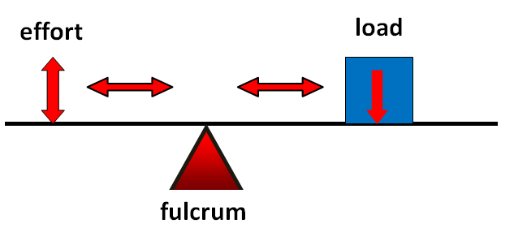
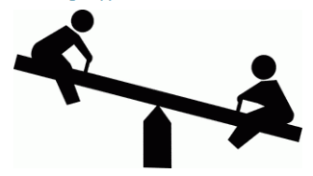
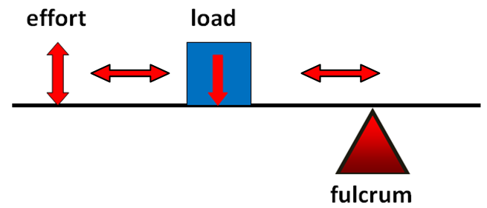
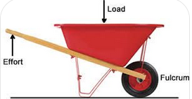
The science of toboggan driving
patroller
patient
Notes:
Back to driver school!
Toboggan driving can be difficult and physically exhausting if the science of toboggan driving is not observed.
When driving large muscle groups are used by preference. Legs are used as opposed to arms for lifting bars wherever possible.
The lower the “effort” used by the driver will allow for safer, more effective and efficient transport of the patient.
First the understanding of leverage, the use of effort and the placement of load relative to the fulcrum or pivot point is important.
Discussion: Students will relate to the science of the “teeter totter” and how the effort is changed by the placement of load on the “teeter totter”. A small and large person can balance by positioning the load differently. Have the diagrams from this slide available when having the discussion with students.
Discussion: Students will relate to the science of the “wheel barrow” which can be compared to the toboggan. When operating the wheel barrow, the closer the load is to the wheel, the easier it is to lift. Compare this to the toboggan where the patient load, position of the patroller relative to the fulcrum make a great difference to the efficacy of driving the toboggan on different terrain and conditions.
Exercise on snow: With or without skis/board on, on level ground, student is in the bars with a load (or a patroller) in toboggan. Move load (or a patroller) forward and then toward rear of toboggan, head “down” and “up” to experience changes in ability to lift the front of the toboggan. To begin with they can face the toboggan and imagine a wheel barrow with the wheel at the back of the toboggan.
Student learning desired outcomes: the science of toboggan driving will reveal a number of things. These include:
with an unloaded toboggan, if bars are locked, effort down on the bars by the driver (patroller) result in the toboggan pivoting on the front edge of the toboggan and the runners of the toboggan lifting off the ground and reducing any steering effect they may have.
this may be good when stationary and wishing to manoeuver the toboggan into a cache or to an incident site
this may be bad if the toboggan is unloaded when driving and the toboggan will begin to spin to the fall line and not track behind the driver
three of the four toboggans described are designed to be driven when unloaded with bars unlocked to maintain the runners on the snow while moving over varied terrain. The fourth, the C.A.T.T. is designed to be driven with bars locked and chain (brake) down at all times (due to design of hull described later)
with a loaded toboggan, the position of the driver (patroller), the load (patient) relative to the fulcrum will influence steering, braking, and amount of strength and energy required.

Slide 4
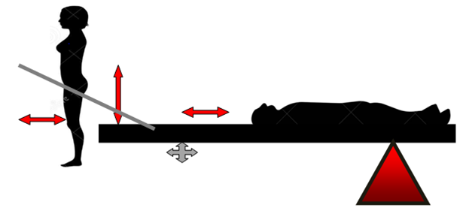
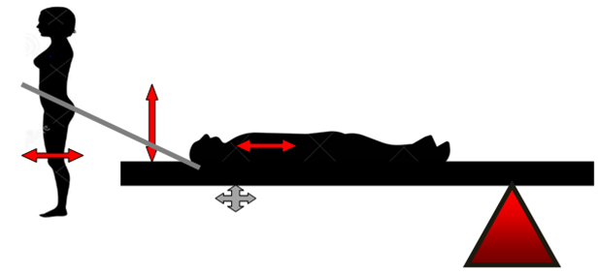
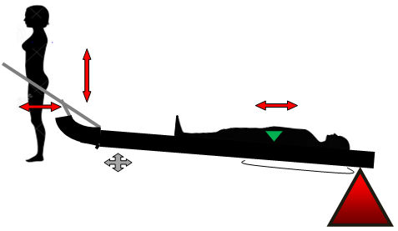
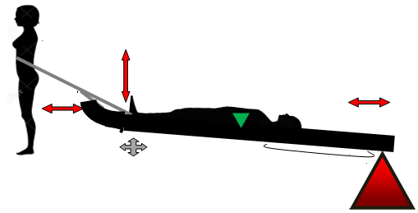
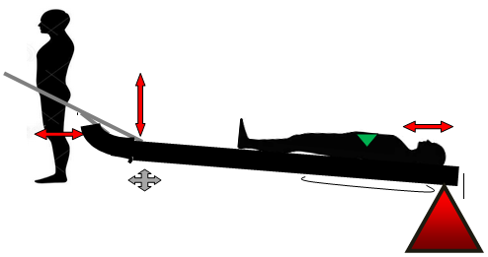
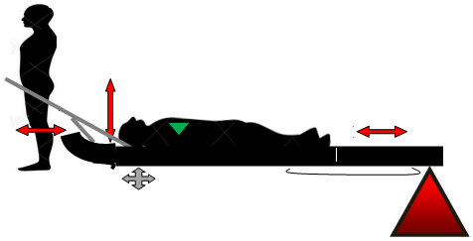
Driver and patient positioning
Driver back in bars and patient loaded further back in toboggan on flatter terrain or heavier snow conditions – easier to release brake
Driver forward in bars and patient loaded closer to front of toboggan on steeper or hard pack (ice) snow conditions – easier to engage brake (*note Edge exception)
Notes:
Safety first
A patroller will competently and confidently demonstrate all skills and knowledge required to drive an unloaded (empty) toboggan prior to driving a loaded toboggan.
In training, the “patient” may be a patroller or in some instances an object or weight to substitute for a patient.
When a weight is used, it must be fully secured in the toboggan to ensure it will not fall out if there is any incident with the transport. Note that use of a weighted object poses challenges for transport to the top of the hill once again as required.
If a patroller is used as the “patient”, the patient will not be strapped in but must be able to “unload” voluntarily if necessary during the training exercise. The patroller may position themselves face down, head down or on their back, head up or down …..positioning can be adjusted by the instructor or driver to experience the impact as shown on this slide. It is recommended that volunteers from the snow sliding public not be used for training purposes with unqualified patrollers due to liability concerns.
As with the unloaded toboggan, the instructor has the opportunity to drive a loaded toboggan from the top of the hill where most toboggans are cached demonstrating all checklist skills listed to arrive at a gentle slope at the base of the hill.
The first loaded toboggan driving experience a patroller will have is on a beginner or gentle slope where there is minimal risk to the patroller, “patient”, equipment, other patrollers or snow sliding public.
The student will experience the movement of the toboggan with bars in the locked position as described in the toboggan specific slides – refer to these for specific slide instructions (Cascade – C.A.T.T. – Edge (Clipper) – Traverse)
*Note that due to the distance between the attachments of the handlebars on the Edge toboggan, the driver may be able to engage brake effectively when back in the bars and pushing down (effort) over the forward attachment, even sitting as suggested by the manufacturer – see “10 tips for loving your Edge”.
Based on the competency and confidence demonstrated by the student, driving practice will move to more moderate and steeper terrain and involve different snow conditions.

Slide 5
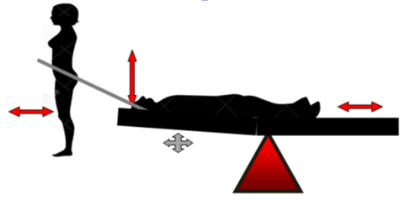
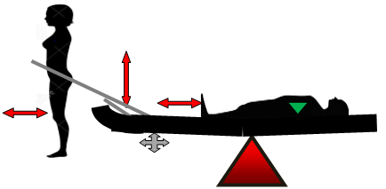
C.A.T.T. mid-toboggan rocker
C.A.T.T. – flat terrain, brake not fully engaged. Driver back in bars, patient loaded toward back of toboggan
C.A.T.T. – steep terrain, brake engaged. Driver forward in bars, patient loaded forward over brake.
Notes:
This slide is similar to the “Driver and patient positioning” slide but showing a mid-toboggan rocker that the manufacturer suggest provides easier braking control of the toboggan

